Slide 1

Build, train, validate, tune and deploy AI models with watsonx
watsonx.ai

Slide 2
...but how enterprises adopt and execute will define whether they unlock value at scale
Foundation Models are bringing an inflection point in AI...
Notes:
The advent of foundation models (FMs), given their remarkable performance and extensibility to a wide range of tasks, is bringing an inflection point in artificial intelligence (AI). Recognizing the significance of this moment, all clients are actively evaluating and seeking to incorporate FMs in their workflows for applications involving generation, summarization, classification, and more.

Slide 3
Generative AI has immense potential to accelerate digital transformation
Scale of impact points to swift adoption over next 3 years
forecasted economic benefits to the global economy across industries
80%
of enterprises will have incorporated Gen AI into their business processes
$3-4T
80%
productivity gains across classes of knowledge workers and creative tasks
70%
of software vendors will integrate Gen AI in their enterprise applications
Source: Gartner
Notes:
This self-explanatory slide points out specific indicators of the impact that generative AI has over digital transformation.

Slide 4
Five truths of generative AI
Truth 1
Multi-model
Truth 2
Truth 3 Governance
Truth 4
Scale for value
Truth 5
Data matters
Multi | hybrid cloud
Two thirds of 150+ enterprises surveyed report pursuing a multi-model strategy
60% + of enterprises pursuing multi-model are experimental with commercial & open-source models
Commercial & open-source innovation
Quickly prioritize use cases that will outlive the model
Multi-modal (text, image, audio, etc.)
One model will not rule them all
Gartner reports that most enterprises will deploy generative AI across hybrid / multicloud environments
Run where the workflows, apps and data live
Infer where business runs to drive performance, cost, and simplicity
Data location to drive security benefits
Regulatory compliance to influence location selection
Surveyed companies report governance as a top requirement, impact of generative AI makes governance more difficult
Businesses must control bias and monitor drift
Organizations must actively monitor hallucinations and ensure model explainability
Leaders must seek practices and tools to ensure model and data provenance
Critical to pick the right use cases and deployment for generative AI ROI
Different work tasks have strongly positive or negative ROI impact
Time savings for a meaningful product innovation +40%; business problem solving -23% time needed
60+ points difference in value for work tasks
25x difference in cost per inference, depending on model and deployment
Generative AI pilots have not made it to production due to challenges with data quality, access, and security
Short run: model innovation creates value
Long run: data quality will decide which enterprises win with generative AI
Notes:
Organizations are increasingly turning to generative AI solutions to gain a competitive edge and unlock new opportunities. As AI adoption accelerates across enterprises, it becomes increasingly crucial to navigate the landscape carefully and responsibly.
Implementing AI is a complex process that requires careful planning and consideration. Businesses must ensure they integrate with existing systems, select the right AI models, consider ethical implications, define the problems they want to solve and scale, and ensure that their data is of high quality.
This self-explanatory slide lists five truths as enterprises look to put AI to work in the most effective and responsible way possible.
Acronym:
ROI: Return on Investment
Sources:
Truth 1: Source: IBM conducted primary interviews to understand enterprises’ foundation model strategy decisions
Truth 2: Source: Cisco and Gartner
Truth 3: IBM Institute of Business Value
Truth 4: Source: Human-Generative AI Collaboration Experiment (May-June 2023); BCG analysis, Decoding the True Cost of Generative AI for Your Enterprise by Maryam Ashoori, PhD

Slide 5
IBM POV: Four core principles to tailor generative AI for enterprise
Open
Targeted
Trusted
Empowering
→ Based on the best AI and cloud technologies available.
→ Designed for targeted business use cases, that unlock new value.
→ Offering security and data protection.
→ On a platform to bring your own data and AI models that you tune, train, deploy, and govern.
→ Built with governance, transparency, and ethics that support increasing regulatory compliance demands.
→ Giving access to the innovation of the open community and multiple models.
→ Including curated models that can be tuned to proprietary data and company guidelines.
→ Running anywhere, designed for scale and widespread adoption to truly create enterprise value.
Notes:
This slide highlights IBM’s point of view (POV) on some vital characteristics of generative artificial intelligence (AI) and foundation models (FMs) used for business. Businesses want a holistic strategy – one that embraces traditional AI and generative AI – the latter must be tailored to the enterprise. IBM’s four core principles to tailor generative AI for the enterprise:
Open – Open source is a rich source of innovation and is a rich source of many FMs (such as those available on Hugging Face). A generative AI platform needs to be open – or it will restrict what is available to its practitioners and lock them in. One model will not rule them all.
Trusted – There are already well-known issues with generative AI platforms like ChatGPT or applications like Google Bard. Generative AI models are known for hallucination (making up answers). Generative AI platforms need to be trusted, offering security and data and model protection. They also need to be architected with governance in mind from the start, not an afterthought and provide transparency, and explainability for their models to support increasing regulatory compliance demands.
Targeted – Platforms like ChatGPT are not targeted. They are used for general consumption and are “generalists” – they are trained on huge amounts of internet-supplied data and require a large overhead to run (clusters of GPU nodes) and are expensive to run (inference) or to fine-tune. Enterprises should look for platforms that provide targeted models (or domain-specific models) for business use cases that can be quickly, effectively, and economically tuned with a small set of proprietary data from the business.
Empowering – Generative AI is not just about FMs, it must provide a platform that empowers enterprises to bring their own data to tune, train, and deploy generative AI models. The platform must also provide governance to ensure proper, responsible usage of the AI models. Moreover, it needs to be able to support running wherever the business wants to, at a desirable scale.
Note:
Hallucination is a well-known phenomenon in a large language model (LLM) in which the system provides an answer that is factually incorrect, irrelevant, or nonsensical because of limitations in it’s training data and architecture.

Slide 6
IBM’s generative AI technology and expertise
AI assistants
Empower individuals to do work without expert knowledge across a variety of business processes and applications.
watsonx Code Assistant
watsonx Assistant
watsonx Orchestrate
watsonx Orders
Consulting
Generative AI strategy, experience, technology, operations
SDKs & APIs
Embed watsonx platform in third party assistants and applications using programmatic interfaces.
Ecosystem
integrations
AI & data platform
Leverage generative AI and machine learning — tuned with your data — with responsibility, transparency and explainability.
watsonx watsonx.ai
watsonx.governance
watsonx.data
Foundation models Granite | IBM Open Source | Hugging Face Llama 3 | Meta
Mistral | Mistral AI
Geospatial | IBM + NASA
Ecosystem
System Integrators, Software and SaaS partners, Public Cloud providers
Data services
Define, organize, manage, and deliver trusted data to train and tune AI models with data fabric services.
Cloud Pak for Data
watsonx Discovery
Hybrid cloud AI tools
Build on a consistent, scalable, foundation based on open-source technology.
Red Hat OpenShift AI
(e.g., Ray, Pytorch)
Notes:
This diagram provides the big-picture context for how watsonx fits into IBM, but it also provides a high-level architectural view of how generative AI technologies fit into enterprises’ IT strategies and practices.
IBM’s generative AI tech stack includes all the components that enable businesses to operationalize AI. Specifically let’s look at the stack from the bottom up:
Hybrid cloud AI tools – IBM provides a scalable foundation to support the entire AI and data lifecycle. Watsonx.ai is powered by Red Hat OpenShift AI which provides a unified platform for businesses to scale workload demands of foundation models (FM). Hybrid managed run systems, on-premises or on the cloud… any cloud. Red Hat Open AI provides clients:
Certified and integrated open-source with technology building blocks (for example, PyTorch, Ray, TGIS, Caikit) for AI model inferencing and customization
Simplifies AI lifecycle management - extends OpenShift to provide a unified, extensible, and embeddable platform for data scientists and application developers, and IT Ops across the entire AI (ML/large language model (LLM)) lifecycle
Reduces complexity of incorporating AI at scale - to meet workload demands of foundation models and deliver consistency at any scale from cloud-to-edge deployments
Data services – An IBM data fabric helps clients build the right data infrastructure for AI. With this architecture, clients automate the discovery, management, and enrichment of data leveraging IBM data governance capabilities to deliver reliable data for AI workflows. IBM Cloud Pak for Data platform helps improve productivity and reduce complexity.
AI and data platforms – Watsonx is an AI and data platform designed to scale and accelerate the impact of AI by infusing intelligence into business operations. The watsonx platform is designed with the three most important components of an effective AI strategy: an AI workspace, data, and governance. Watson.ai is a next generation enterprise studio for AI builders to train, validate, tune, and deploy AI models. Watsonx.data is an open, hybrid, and governed data lakehouse optimized for all data and AI workloads. And watsonx.governance allows clients to direct, manage, and monitor their organization’s AI activities, and employs software automation to strengthen a client’s ability to mitigate risk, manage regulatory requirements, and address ethical concerns.
Software development kits (SDKs) and application programming interfaces (APIs) – Programmatic interfaces that embed watsonx capabilities in watsonx AI assistants and applications.
AI assistants – Pre-built applications powered by watsonx. Clients can deploy watsonx AI assistants to do work without expert knowledge across a variety of business processes and applications, including automating customer service, generating code, and automating key workflows in departments such as human resources (HR).

Slide 7




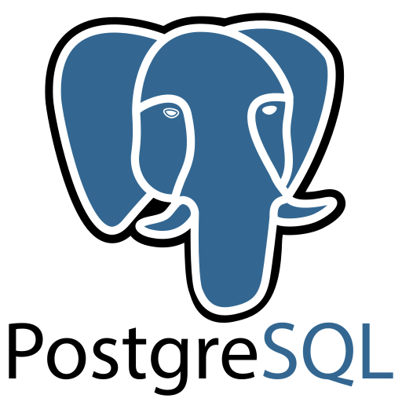
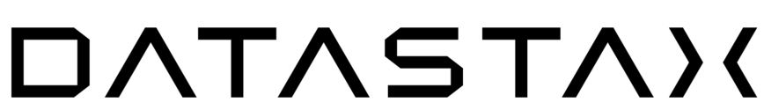






IBM Cloud Pak for Data
Investments in an open and trusted data foundation will accelerate and scale your AI initiatives
Databases
Data Fabric
watsonx™
Scale and accelerate the impact of AI with trusted data
AI and Data Platform
watsonx.ai
watsonx.data
watsonx.governance
AI Assistants
watsonx Orchestrate
watsonx Assistant
watsonx Code Assistant
Store, unify, and share data with open formats and native integrations
Simplify data access across the enterprise and hybrid cloud environments with a data fabric architecture
Database
IBM Db2
IBM Informix
Data Governance
IBM Knowledge Catalog
Manta
Data Integration
IBM DataStage
IBM Data Replication
IBM Data Virtualization
Data
Delivering quality data to consumers and users
Data Warehouse
IBM Db2 Warehouse
IBM Netezza
Data as a Product
Delivering data products
Data Lakehouse
IBM watsonx.data
AI
Enabling data teams to be more productive with automated insights
Data Observability
IBM Databand
Master Data Management
IBM Master Data Management
3rd party databases
Any many more
Automated data lineage
Gain deeper visibility into your data and its journey from source to end-use for regulatory compliance and AI use cases with Manta, an IBM company
© 2023 IBM Corporation
Notes:
As we know, it is also critical to deliver trusted data because AI is only as good as the data that fuels it.
This dependency on data for successful implementations of AI, underscore the importance of the CDO’s role in AI.
IBM enables clients to simplify access and consumption of data for AI workflows by leveraging an open and trusted data foundation
We provide native integrations across our databases portfolio and support open formats such as Iceberg, enabling the ability to store, unify, and share data for analytics and AI without additional ETL or duplication of data. For example, Amazon RDS for Db2 natively integrates with Db2 Warehouse and watsonx.data lakehouse on AWS to prepare transactional data for analytics and AI. Cloudera, Snowflake, Amazon Redshift, and any 3rd party analytics engine that supports Iceberg can now unify data and optimize workloads with multiple query engines in watsonx.data.
But that’s not enough. Customers have databases from a lot of different sources and fit for purpose databases across every database type. For that, you need a data fabric. With a data fabric architecture, clients can automate discovery and enrichment of data with our centralized data governance capabilities, enable data observability across various pipelines, employ various data integration styles, and management of data quality to deliver reliable data for AI workflows
This feeds watsonx itself, where all of your AI workloads can be executed with trusted and high quality data.
With the IBM data fabric architecture, clients leverage a unified platform that makes all data—spanning hybrid and multicloud environments—available for AI workflows; this composable and modular architecture provides the flexibility for clients to utilize the pertinent capabilities they need, while maximizing their existing infrastructure.

Slide 8
Put AI to work with watsonx.
Notes:
Clients can put AI to work with watsonx
Scale and accelerate the impact of AI with trusted data.
Train, tune and deploy AI across your business, leveraging critical, trusted data wherever it resides.
IBM watsonx is an exciting new IBM AI and data platform that represents five years of focused effort in the making. Recalling when Watson first started and competed on Jeopardy, it’s been nearly 13 years of work that has gotten IBM to this moment. And it's not just IBM, because IBM is integrating partners (like Hugging Face, where the targeted communities share open models) as part of this solution in AI for business, one model will not rule them all.

Slide 9
watsonx Scale and accelerate the impact of AI across your business
The platform for AI and data
watsonx.ai
Build, train, validate, tune and
deploy AI models
watsonx.data
Scale AI workloads, for all
your data, anywhere
watsonx.governance
Accelerate responsible, transparent and explainable AI workflows
A next generation enterprise studio for AI builders to build, train, validate, tune, and deploy both traditional machine learning and new generative AI capabilities powered by foundation models. It enables you to build AI applications in a fraction of the time with a fraction of the data.
Fit-for-purpose data store, built on an open lakehouse architecture, supported by querying, governance and open data formats to access and share data.
End-to-end toolkit for AI governance across the entire model lifecycle to accelerate responsible, transparent, and explainable AI workflows
Notes:
The new IBM platform for artificial intelligence (AI) and data, watsonx is designed with the three critical elements of an AI strategy in mind. It empowers enterprises to train, tune, and deploy AI across the business, leveraging critical, trusted data wherever it resides.
This platform has three components:
watsonx.ai - a studio that clients can use to train, validate, tune, and deploy both machine learning (ML) AI models as well as foundation models for generative AI. These models combine best-of-breed architectures with a rigorous focus on data acquisition, provenance, and quality, to serve enterprise needs.
watsonx.data - makes it possible for enterprises to scale AI workloads using all their data with a fit-for-purpose data lakehouse service optimized for governed data and AI workloads, supported by querying, governance, and open data formats to access and share data. This is based on open-source technologies, including Presto and Iceberg.
watsonx.governance - helps companies put AI into production by providing an end-to-end solution that encompasses both data and AI governance to enable responsible, transparent, and explainable AI workflows. AI governance helps business analysts understand the trustworthiness of their AI solutions.

Slide 10

watsonx Scale and accelerate the impact of AI across your business
Select and tune AI models for better performance and TCO
IBM models trained in targeted domains
Curated library of third-party, open-source models
Studio to train, validate, tune, and deploy models
Scale AI use cases faster
Data store to access and share all your data
Choice of infrastructure, from on premises to the cloud
AI assistants to accelerate adoption
Expertise to take AI from pilot to production
Implement AI with trust
AI lifecycle governance, from training and tuning to deployment
Model guardrails and IBM model indemnification
Data governance, from quality to privacy and compliance
Notes:
This self-explanatory slide highlights how clients can scale and accelerate the impact of AI across their businesses with IBM watsonx.
Acronym:
TCO: Total Cost of Ownership

Slide 11
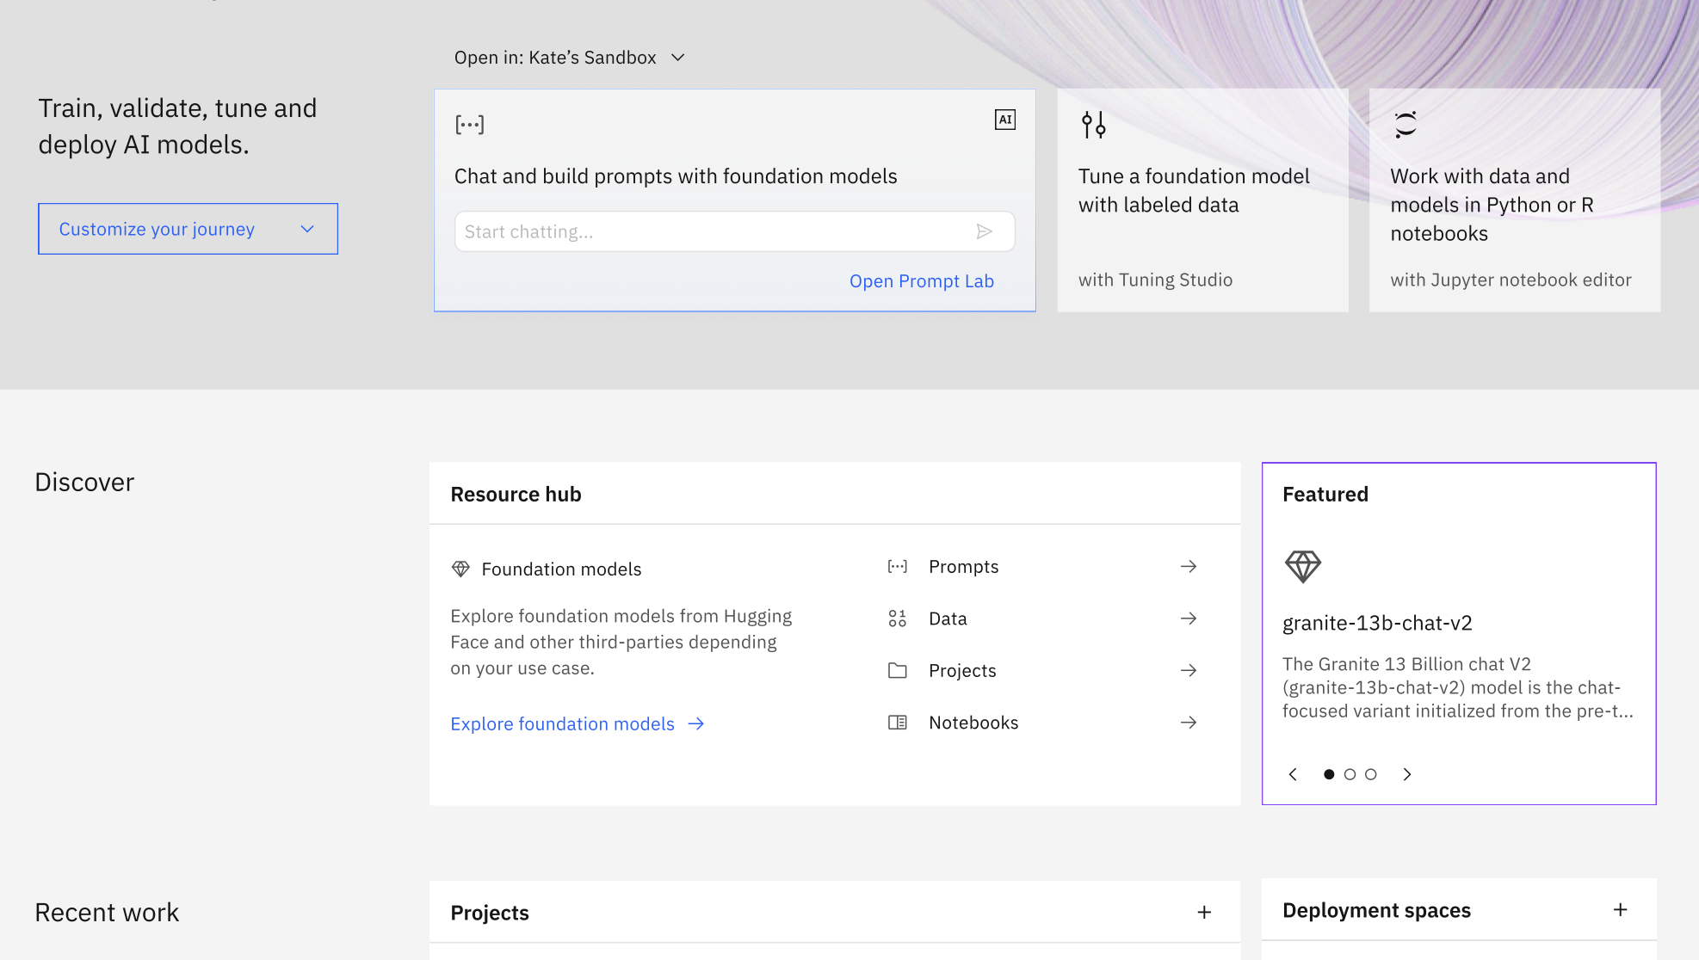
watsonx.ai
Build, train, validate, tune, and deploy AI models
A next generation enterprise studio for AI builders to train, validate, tune, and deploy generative AI, foundation models, and machine learning capabilities.
The watsonx.ai components include:
New InstructLab for collaborative language model enhancements to rapidly train and release models (2H24 availability)
Foundation Model Library with IBM, third-party and open-source models
Prompt Lab to experiment with foundation models and build prompts for various use cases and tasks
Tuning Studio to tune your foundation models with labeled data
Data Science and MLOps to build machine learning models automatically with model training, development, visual modeling, and synthetic data generation
© 2024 IBM Corporation
11
Notes:
IBM watsonx.ai. is an enterprise studio to train, validate, tune, and deploy traditional machine learning (ML) and foundation models (FMs) that provide generative AI capabilities. IBM watsonx.ai components include a Foundation Model Library, a Prompt Lab, a Tuning Studio, and Data Science and Machine Learning Operations (MLOps) capabilities. Specifically:
InstructLAB: offers an intuitive way for a collective community style collaboration of skills and knowledge to Language Models to enable one model resulting in rapid iterative release of models.
Foundation Model Library - Clients have access to a family of IBM models of different sizes and architectures, IBM selected open-source models from the Hugging Face community, and other third-party models including Llama and StarCoder large language model (LLM) for code generation.
Prompt Lab - AI builders can work with FMs through prompts and experiment with zero-shot, one-shot, or few-shot prompting to support a range of natural language processing (NLP) type tasks including question answering, content generation, summarization, text classification, and extraction. This lab helps beginners to experts build, manage, and benchmark their prompts.
Tuning Studio - FMs can be further customized for better performance. Tuning can be useful to adapt existing models to domain-specific tasks (for example, learn new tasks or be very domain specific). Tuning also allows businesses to harness their proprietary data to differentiate their applications with focused, business data.
Data Science and MLOps - IBM provides all the tools, pipelines and runtimes powered by FMs a business needs to support building ML models automatically. Clients can automate their entire AI model lifecycle from development to deployment with connections to a variety of application programming interfaces (APIs), software development kits (SDKs), and libraries. You can even address any data gaps with by creating synthetic tabular data.

Slide 12
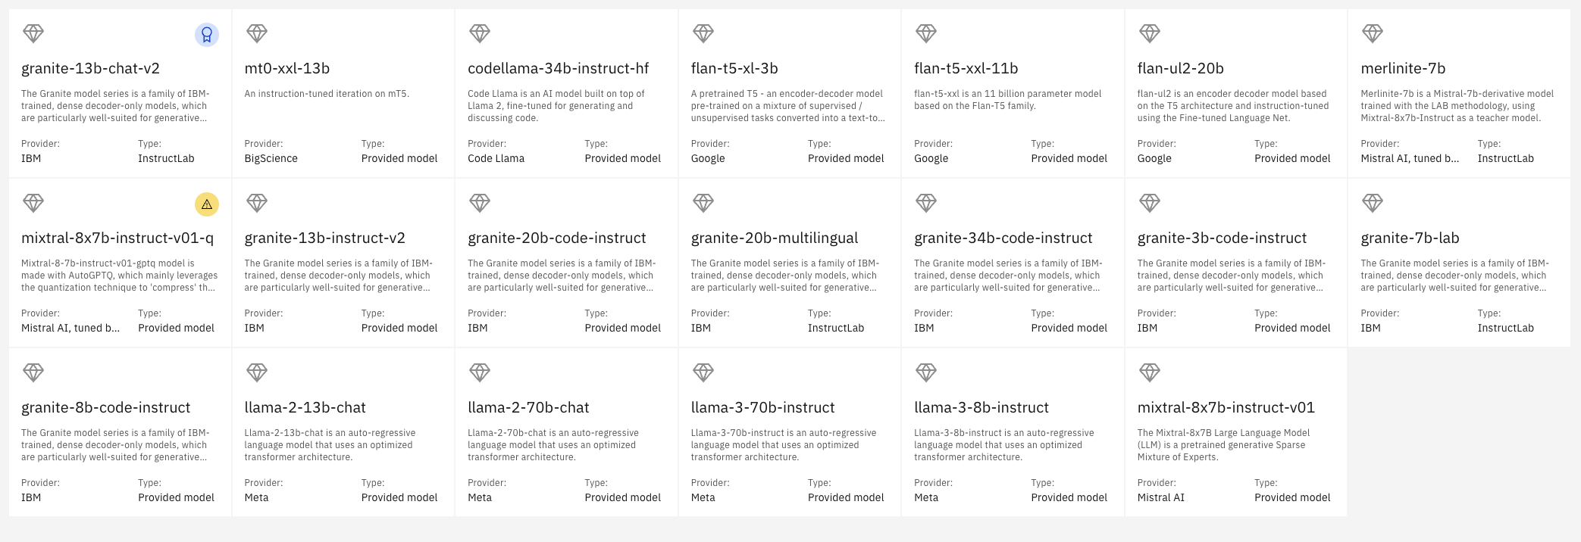

IBM watsonx model library – Foundation Models available today
Model in deprecation

Slide 13
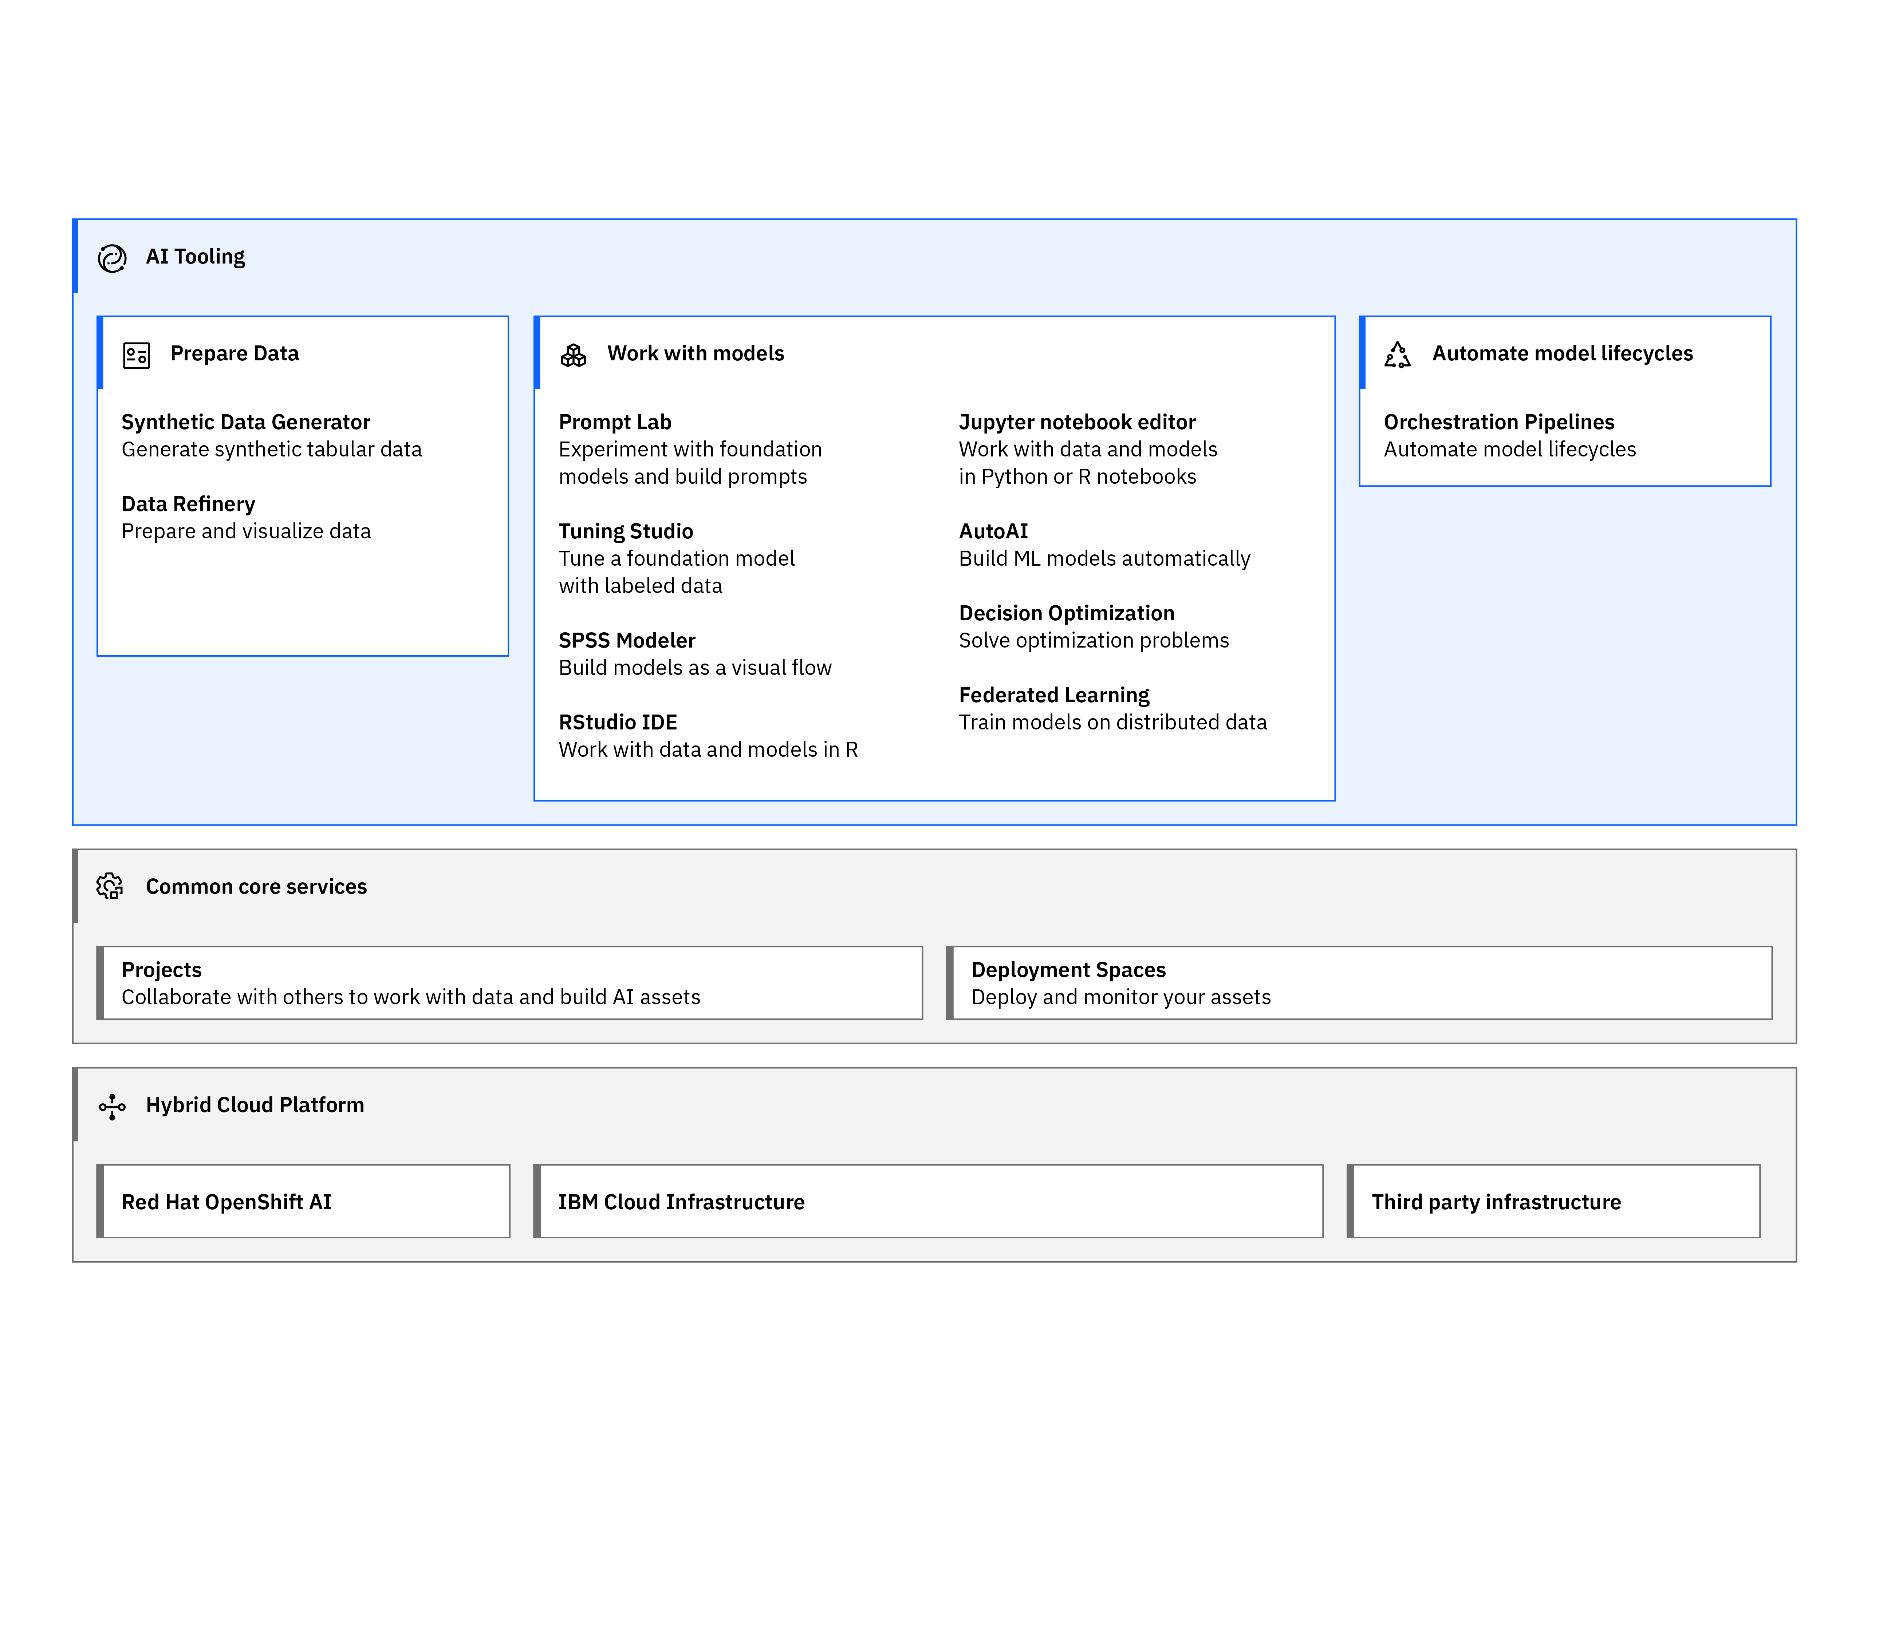
IBM watsonx.ai architecture
Common core services
Collaborative projects
Deployment spaces
Jobs
Notifications
Common connectivity
Access and Authentication
Resource management
Central asset management system

Slide 14




















Companies are already leveraging IBM watsonx.ai™ to transform processes and experiences
Notes:
Finally we couldn’t do anything without client outcomes… here’s examples from some of our clients /partners onhow they are adopting generative AI with watsonx to transform their business processes

Slide 15
Why IBM?
Open
IBM’s AI is based on the best open technologies available
Trusted
IBM’s AI is transparent, responsible, and governed
Targeted
IBM’s AI is designed for enterprise and targeted at business domains
Empowering
IBM’s AI is for value creators, not just users
Notes:
IBM has a strong point of view (POV) on the four key factors that drive a successful generative artificial intelligence (AI) platform and the watsonx.ai differentiators. Specifically, IBM AI is:
Open
IBM watsonx.ai is a hybrid cloud-native stack built on Red Hat OpenShift. This allows watsonx to integrate easily with other IBM cloud services such as Watson Studio, Watson Knowledge Catalog, Watson Query, and more. It also means watsonx.ai is hybrid and multicloud enabled. IBM’s partnership with Hugging Face provides clients with access to the best collection of open-source models available.
Trusted
IBM has a long history of building secure AI and data platforms. This focus is carried over to watsonx.ai to ensure IBM’s suite of foundation models (FMs) is built on the principles of trust, making them ready for business applications.
As a start, IBM’s models are trained on highly curated, scrutinized, and strong efforts to only include copyright-free data, that were also filtered to weed out inappropriate content.
The integration with watsonx.governance provides a trusted pathway to operationalize AI confidently and at scale. Watsonx.ai is an AI platform that lets clients run responsible, transparent, and explainable AI.
Targeted
Watsonx.ai is designed for targeted business use cases to unlock new value for customers. Specifically:
It can be on-premises, hybrid, and IBM cloud.
It is designed to be scalable – matching the needs of clients.
Various models of different sizes, different architectures (encoder, decoder, encoder-decoder) and domain-specific models (finance, cybersecurity, and more) will be available for clients to pick the best model to use or tune for their business use cases.
Watsonx.ai also includes industry-leading support to help clients to implement their use cases.
Empowering
Watsonx.ai is designed for AI value creators, not just users. Models can be tuned at a fraction of the cost (clients pick the right size, architecture, and domain) and they can be deployed anywhere.
Watsonx.ai console allows clients to build, tune, and deploy their models. Clients can use their own data to create differentiated AI assets.

Slide 16
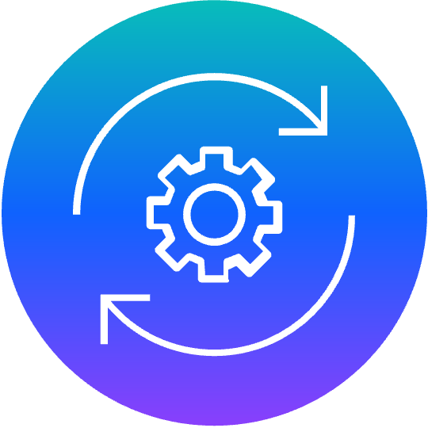
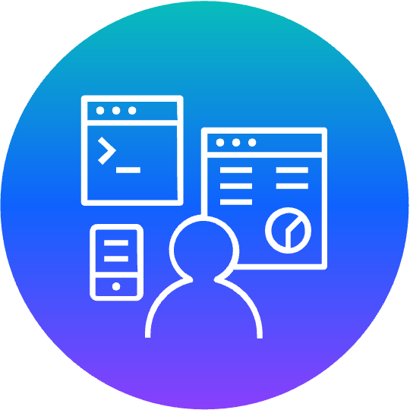
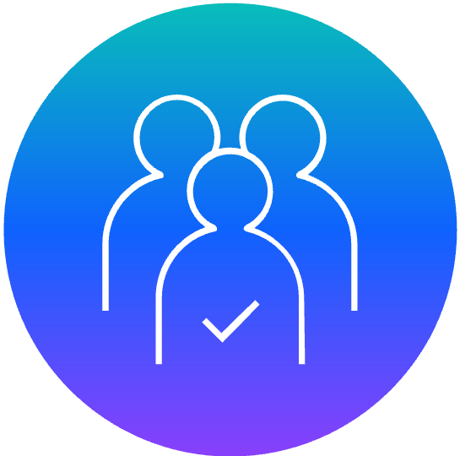
The AI Alliance
IBM has long recognized that when it comes to the future of AI, an open and transparent approach is the strongest path forward.
AI Alliance, launched by IBM and Meta with more than 50 leading industry, academic, research and government organizations globally who will work together on creating actionable plans that advance responsible and inclusive AI that’s rooted in open innovation.
Brings together a critical mass of compute, data, tools, and talent to build and support open technologies across software, models, and tools
Enable developers and scientists to understand, experiment, and adopt open technologies
Advocate for open innovation with organizational and societal leaders, policy makers and regulatory bodies, and the public
Inquiries? You can share comments and questions at thealliance.ai
Notes:
IBM has long recognized that when it comes to the future of AI, an open and transparent approach is the strongest path forward. With this great technology comes great responsibility, which requires the global collective — researchers, builders, adopters, and advocates — working hand-in-hand to chart a course for AI that adheres to our most fundamental principles: diversity, safety, responsibility, and true ingenuity.
AI Alliance, launched by IBM and Meta with more than 50 leading industry, academic, research and government organizations globally who will work together on creating actionable plans that advance responsible and inclusive AI that's rooted in open innovation.
It is also an embodiment of IBM's commitment to managing AI responsibly and at scale, which will now be further enabled by the general availability of watsonx.governance (to enable responsible, transparent and explainable data and AI workflows)
IBM and Meta Launch the AI Alliance in collaboration with over 50 Founding Members and Collaborators globally including AMD, Anyscale, CERN, Cerebras, Cleveland Clinic, Cornell University, Dartmouth, Dell Technologies, EPFL, ETH, Hugging Face, Imperial College London, Intel, INSAIT, Linux Foundation, MLCommons, MOC Alliance operated by Boston University and Harvard University, NASA, NSF, Oracle, Partnership on AI, Red Hat, Roadzen, ServiceNow, Sony Group, Stability AI, University of California Berkeley, University of Illinois, University of Notre Dame, The University of Tokyo, Yale University and others

Slide 17
The most common generative AI tasks implemented today
Retrieval-augmented generation
Based on documents or dynamic content, create a chatbot or question-answering feature.
Building a Q&A resource from a broad knowledge base, providing customer service assistance
Summarization
Transform text with domain-specific content into personalized overviews that capture key points.
Conversation summaries, insurance coverage, meeting transcripts, contract information
Content generation
Generate text content for a specific purpose.
Marketing campaigns, job descriptions, blog posts and articles, email drafting support
Named entity recognition
Identify and extract essential information from unstructured text.
Audit acceleration, SEC 10K fact extraction
Insight extraction
Analyze existing unstructured text content to surface insights in specialized domain areas.
Medical diagnosis support, user research findings
Classification
Read and classify written input with as few as zero examples.
Sorting of customer complaints, threat and vulnerability classification, sentiment analysis, customer segmentation
Notes:
Generative artificial intelligence (AI) has many applications. Some of the most common tasks they are good at include:
Retrieval-augmented generation (RAG) – An AI framework for improving the quality of large language model (LLM)-generated responses by grounding the model on external sources of knowledge to supplement the LLM’s internal representation of information. RAG retrieves data from outside a foundation model (FM) (like from watsonx.data) and augment prompts by adding the relevant retrieved data in context The external data used to augment prompts can come from multiple data sources, such as a document repositories, databases, or application programming interfaces (APIs). RAG also provides a level of explanation and more up to date since the date source is explanatory.
Summarization – Takes a large body of text (such as meeting minutes, contract documents, etc.) and summarize the key points.
Content generation – The main capability of chatbots (like ChatGPT and others) – it generates text content for specific purposes. In business context, this can help employees create email drafts, marketing materials, job postings, and more.
Named entity recognition (NER) – A natural language processing (NLP) method that extracts information from text. The category can be generic like organization, person, location, or a custom category depending on the use case such as the U.S. Securities and Exchange Commission (SEC) documents.
Insight extraction – Used to analyze and extract essential information. Enterprises have a lot of unstructured data from PDF, Parquet, JSON, and other open-source data structures. Generative AI can be used to extract information.
Classification – Read an input and provide classification based on business terminologies and specific categories. This can apply to sentiment analysis, security vulnerability classification, and more.

Slide 18
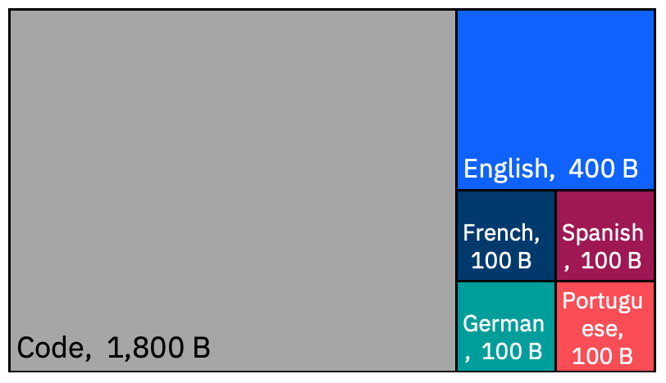
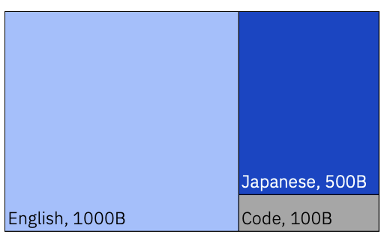
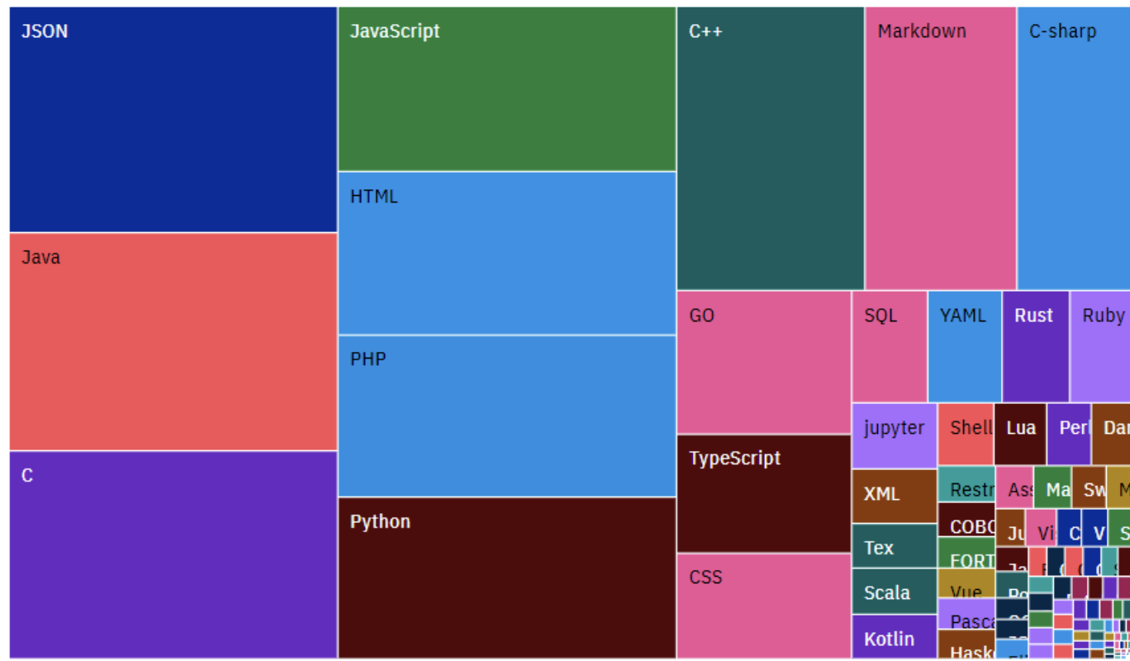

What is IBM Granite ?
Trusted, Performant, ​Cost-effective AI foundation models purpose built for enterprises.​
Granite is IBM's flagship series of LLM foundation models based on decoder-only transformer architecture.
Granite language models are trained on trusted enterprise data spanning internet, academic, code, legal and finance.
granite-13b-v2 ( English LLM ) -chat-v2.1, -instruct-v2
granite-20b-multilingual
granite-8b-japanese
13B parameters in size 2.5T tokens of data
20B parameters in size 2.6 T tokens of Data
8B parameters in size 1.6T tokens of Data
(v1 breakdown)
Chat derivative model is optimized for dialogue use cases and works well with virtual agent and chat applications.​
Instruct derivative model was designed to perform well on natural language tasks and can be customized for specific industries and domains via prompt-tuning.
granite-7b-lab
Open-source
granite-code
Open-source
7B parameters in size
3B, 8B, 20B, 34B parameters in size
Tuned using IBM’s large-scale alignment of chatbots(LAB).
A family of models trained in 116 programming languages
By 2027 more than 50% of the Gen AI models that enterprises use will be domain-specific — specific to either an industry or business function — up from approximately 1% in 2023.
Gartner Report, Predicts 2024: The Future of Generative AI Technologies.
Granite-code-20b
IBM open-source models : https://huggingface.co/ibm-granite

Slide 19
Why IBM Granite ?
Shining example of 'IBM's differentiated approach to delivering enterprise-grade foundation models' in practice, driving outcomes.
Trusted
IBM Granite was trained on enterprise relevant content that meet rigorous data governance, regulatory and risk criteria defined and enforced by IBM AI Ethics code and Office of Privacy and Responsible Technology. IBM stands behind its Granite models by offering its standard IP indemnification protection to provide clients with peace of mind
Performant
Improved accuracy for targeted enterprise business domains like Finance and use cases like RAG achieved through chat fine tuning and model alignment techniques.
Cost-effective
Competitively priced model with less infrastructure requirement, IP indemnification, and easy-to-use toolkit for model customization and application integration.

Slide 20
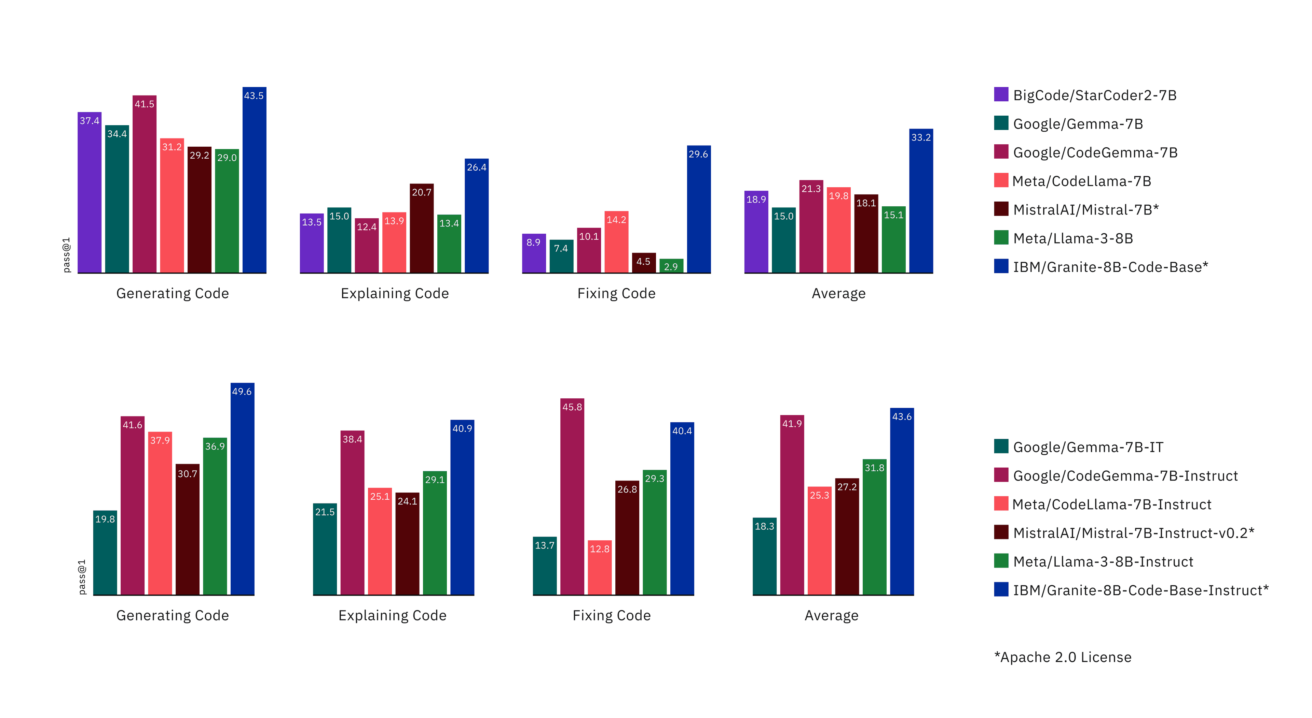
Performant
IBM Granite code models demonstrate superior performances on code synthesis, fixing, explanation, editing, and translation, across most major languages, incl. Python, JavaScript, Java, Go, C++, and Rust
Comparing the Granite-8B-Code (Base/Instruct) with other similarly sized open-source code LLMs on HumanEval Pack. Three coding tasks and six programming languages were used.
^{[1]}Research paper on Granite code models

Slide 21
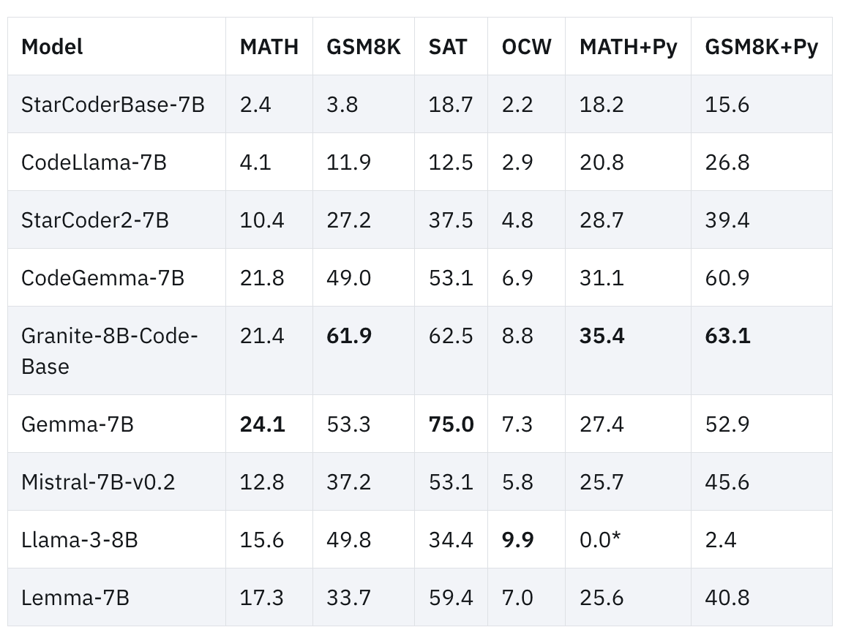
Performant
IBM Granite code models demonstrate superior performances on code synthesis, fixing, explanation, editing, and translation, across most major languages, incl. Python, JavaScript, Java, Go, C++, and Rust.
Granite models can outperform some twice their size, such as with Code Llama, and while some other models may perform slightly better in some tasks like code generation, no one model could perform at a high level at generation, fixing, and explanation — apart from Granite.^{[1]}
^{[1]}Research paper on Granite code models

Slide 22
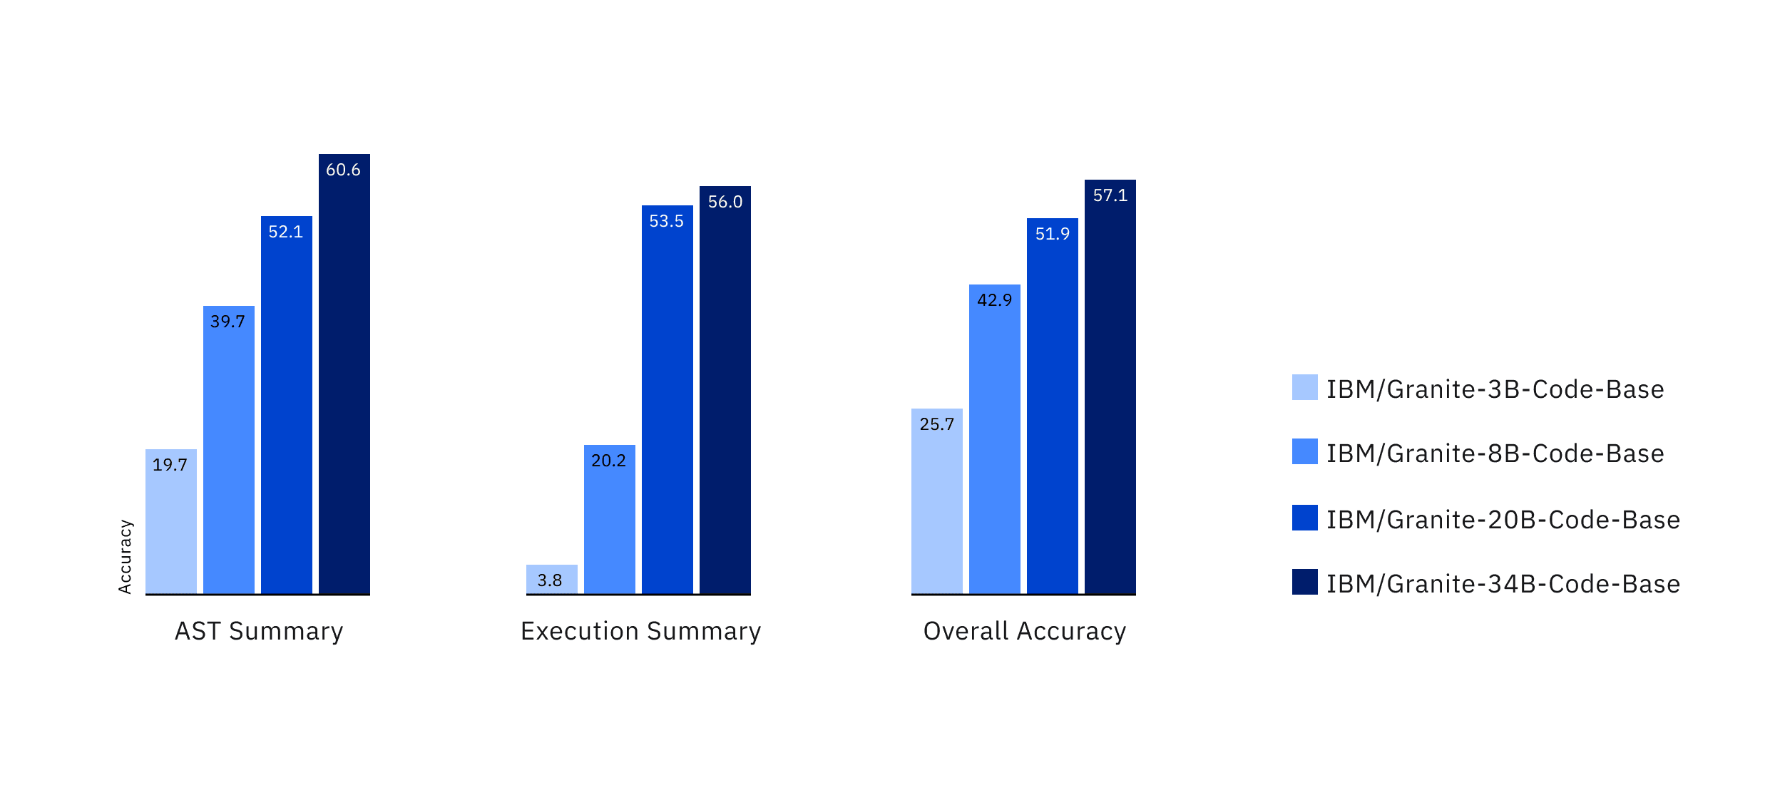
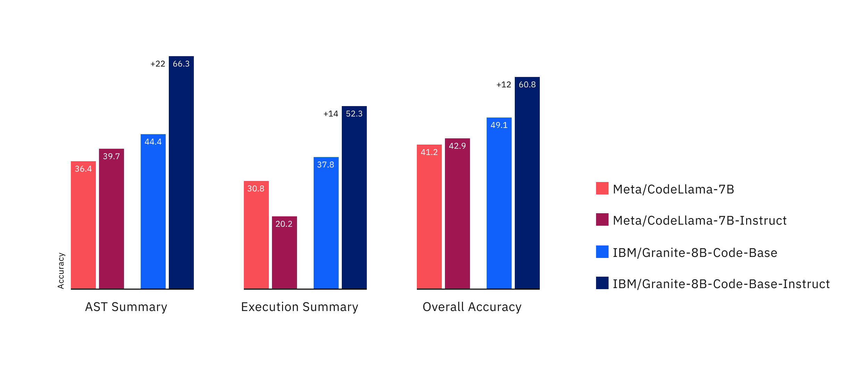
Performant
IBM Granite code models demonstrate superior performances on code synthesis, fixing, explanation, editing, and translation, across most major languages, incl. Python, JavaScript, Java, Go, C++, and Rust.
On the Berkeley Function-Calling Leaderboard, the accuracy of Granite Code models keep increasing as the model size increases. ^{[1]}
On Berkley Function-Calling Leaderboard, the Granite-8B-Code model (Base and Instruct) consistently outperform CodeLlama-7B (Base/Instruct) on all three metrics. ^{[1]}
^{[1]}Research paper on Granite code models

Slide 23

IBM Client Engineering
LLMOps IBM‘s Narrative and Practical Pattern
Feb 2024
IBM Client Engineering / © 2024 IBM Corporation

Slide 24
Agenda
LLMOps Overview
What’s LLMOps
Why LLMOps
Common Use-cases & Business Values
Comprison with Traditional MLOps
Architecture
Discussion: What’s Your Current Status & Future Plan

Slide 25


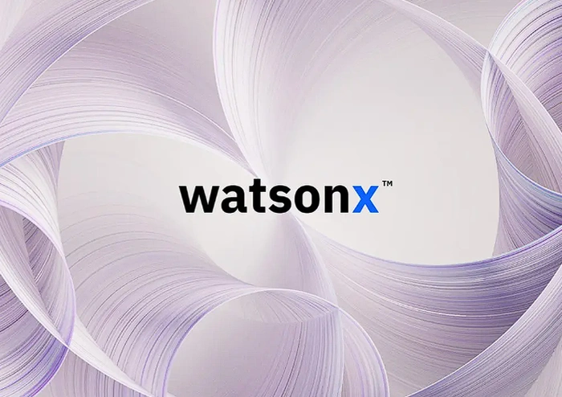






LLMOps – IBM Narrative
LLMOps is a part of MLOps that focuses on Large Language Models (LLMs). It refers to the specialized practices and workflows that speed development, deployment and management of LLMs throughout their complete lifecycle.
IBM® watsonx™ AI and data platform help you get started with LLMOps based on the following principles:
Open: Based on open technologies that provide a variety of models to cover enterprise use cases and compliance requirements.
Targeted: Targeted at enterprises and designed for business use cases that unlock new value.
Trusted: Designed with principles of transparency, responsibility and governance so you can manage legal, regulatory, ethical and accuracy concerns.
Empowering: Go beyond being an AI user and become an AI value creator, owning the value your models create.
Data Management
Pre-trained LLM
Fine-tuning
Embedding
Prompt-tuning
Validation
Explainability
Deployment
Notes:
https://www.snowflake.com/guides/llmops-operationalizing-large-language-models/
https://www.ibm.com/topics/llmops

Slide 26
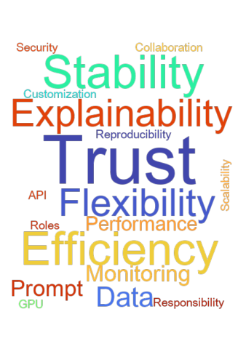
Key Drivers (Why LLMOps)
Efficiency: do more with less through collaboration, computational cost reduction, iteration and feedback
Risk reduction: improve security and privacy
Scalability: continuous integration, delivery and deployment environment
Trust: high-quality models with proper monitoring, reproducibility, explainability
Flexibility: customized for different use cases, exposed as API
Group Name / DOC ID / Month XX, 2022 / © 2022 IBM Corporation

Slide 27
Common
Use Cases
HR, Finance, and Supply Chain
Customer Service
IT
Operations
Customer service
Empower customers to find solutions with easy, compelling experiences
HR automation
Reduce manual work and automate recruiting, sourcing and nurturing job candidates
App modernization, migration
Generate code, tune code generation response in real time
Threat management
Reduce incident response times from hours to minutes or seconds
IBM is actively engaging with enterprise clients across a broad set of business domains
Automate answers with 95% accuracy
Reduce employee mobility processing time by 50%
Deliver faster development output
Contain potential threats 8x faster
Marketing
Increase personalization, improve efficiency across the content supply chain
Supply chain
Automate source to pay processes, reduce resource needs and improve cycle times
IT automation
Identify deployment issues, avoiding incidents, optimize application demand to supply
Asset management
Optimize critical asset performance and operations while delivering sustainable outcomes
Reduce content creation costs by up to 40%
Reduce cost per invoice by up to 50%
Reduce mean time to repair (MTTR) by 50%+
Reduce unplanned downtime by 43%
Non-exhaustive
Content creation
Ex. Enhance digital sports viewing with auto-generated spoken AI commentary
Planning and analysis
Make smarter decisions, focus on higher value tasks with automated workflows and A.
AIOps
Assure continuous, cost-effective performance and connectivity across applications
Product development
Ex. Expedite drug discovery by inferring structure with AI from simple molecular representations
Scale live viewing experiences cost effectively
Process planning data up to 80% faster
Reduce application support tickets by 70%
Faster and less expensive drug discovery
Knowledge worker
Enable higher value work, improve decision making, and increase productivity
Regulatory compliance
Support compliance based on requirements / risks, proactively respond to regulatory changes
Data platform engineering
Redesign the approach for data integration using generative AI
Environmental intelligence
Provide intelligence to proactively plan and manage impact of severe weather and climate
Reduce 90% of text reading and analysis work
Reduce time spent responding to issues
Reduce data integration time by 30%+
Increase manufacturing output by 25%
27
Notes:
This self-explanatory slide highlights the early use cases and their associated outcomes when artificial intelligence (AI) is applied.
Acronyms:
HR: Human Resources
AIOps: Artificial Intelligence for IT Operations
Source:
IBM internal data

Slide 28
Comparison with MLOps
LLMOps
Start from pre-trained LLMs
Does not require training, or with prompt tuning or fine tuning
Usually unstructured data, amount depends on training type
Development does not require coding skills to get started
Different set of evaluation metrics
Prompt as extra part of model development
Resource cost as a key factor for optimization
Extra risk factors on privacy and hallucination
Traditional MLOps
Start from scratch
Training with different models to compare
Usually tabular data, relatively large amount
Development requires coding skills
Time consuming and more complex
Note: above is not intended to be an exhaustive list
Group Name / DOC ID / Month XX, 2022 / © 2022 IBM Corporation

Slide 29
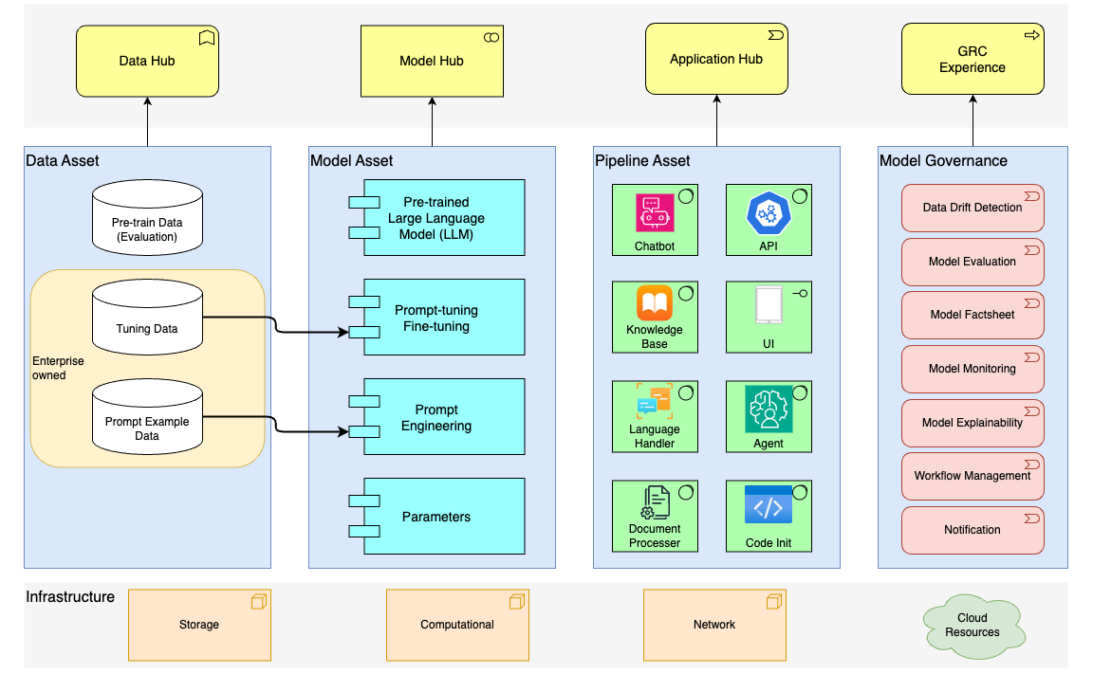
Architecture

Slide 30
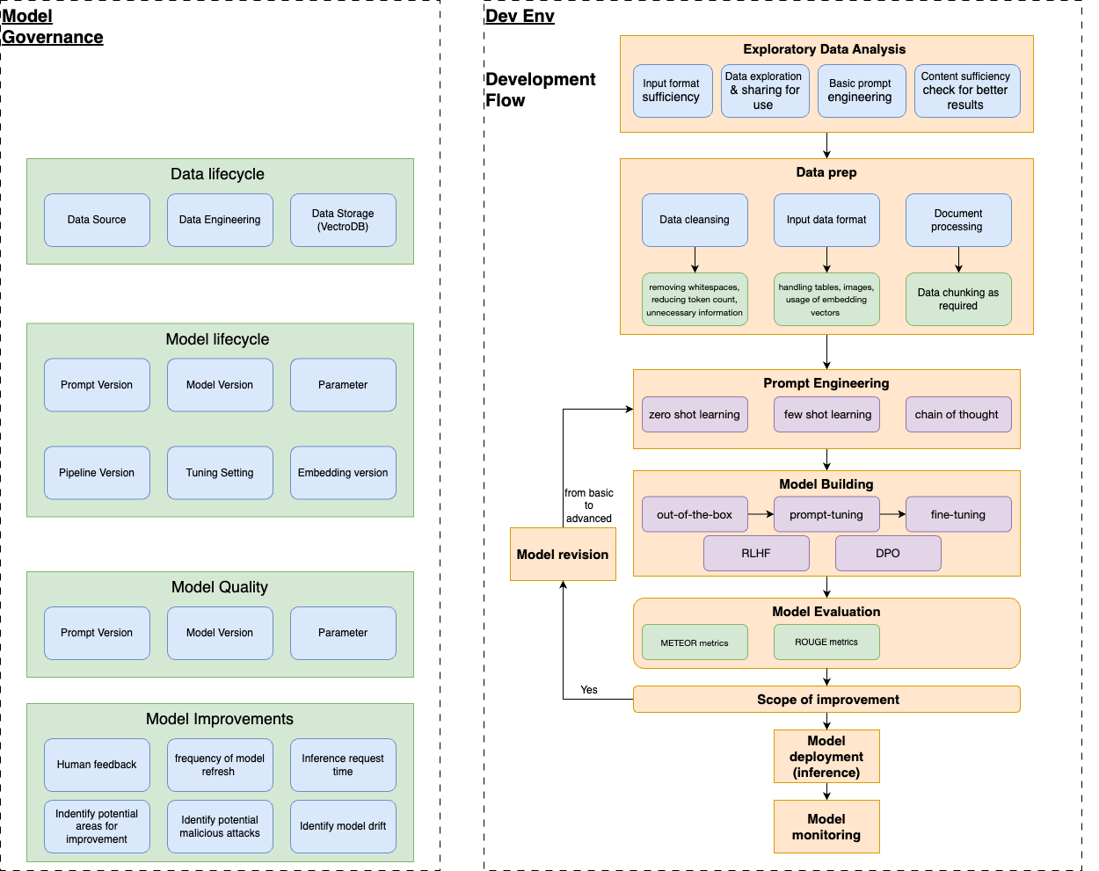
Workflow

Slide 31
Our Differentiators (IBM’s Positioning)
Tailored to Enterprise
Model Library
Governance
Co-Creation
→ One model doesn’t fit all use cases. We offer IBM-developed, open-source, third party, and BYOM.
→ Designed for targeted business use cases. Models can be tuned to your proprietary data for each use case.
→ Monitoring and alerts. Get alerts when LLM thresholds are breached
→ Model isn’t everything. Technical expertise is crucial for a successful LLM application.
→ AI Transparency. Capture model metadata automatically
→ We dive deep. Business value is always our prioritization. Services teams sit together with business users and continuously improve our AI application.
→ Bigger is not always better. Specialized models can outperform general-purpose models with lower infrastructure requirements and costs.
→ Build your own model. With your own data, enterprises can tune, train, deploy and govern their models as part of their IP.
→ Manage AI Lifecycle. Collaborate across stakeholders and adhere to internal policies and regulations

Slide 32
Discussion Your Current Status & Future Plans
Example questions for clients to get started
Which business use case do you think LLMs can help?
What kind of output do you expect to get from LLMs?
Have you already tried to use LLMs in your business and any difficulties?
Do you what to try SaaS or targeted for on-prem deployment?
How much computational resources do you have? i.e. GPUs
Let’s get prepared for GenAI!
Business
Resources
Data
Skills
How much computational resources do you have? i.e. GPUs
Do you think your organization have the data to support the proposed LLM use case? (for example, documents, customer call scripts, code examples)
Do you have a dedicated data/AI team that can develop LLM applications?
How long have your team been working on LLM related projects?

Slide 33
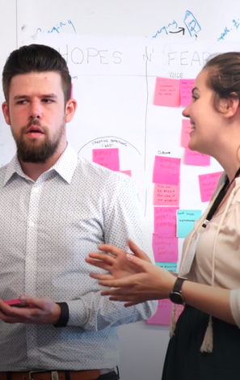
Discussion Your Current Status & Future Plans
Summary & Ideation
Example
Use Cases
Expectation
Persona
& Team
Data
Resources
Help developer with code validation, translation, app development, etc
Code
Assistant
IT Dept
Coding Examples
GPU
Private Cloud
Knowledge Based Search

Slide 34
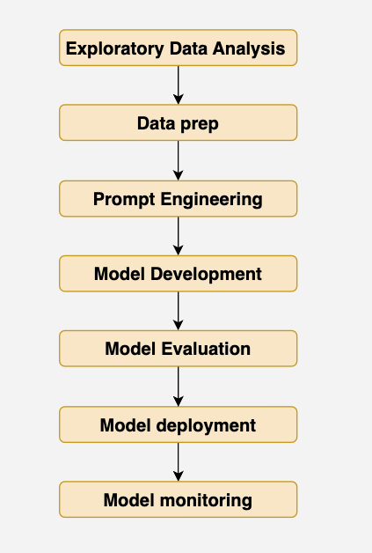
Developing LLMs on watsonx.ai
Steps following LLMOps practice:
EDA: Watson Studio, Prompt Lab
Data Prep: Watson Studio, Milvus
Prompt Engineering: Prompt Lab
Model Development: Tuning Studio
Model Evaluation: Watson Studio, OpenScale
Model Deployment: Watson Machine Learning
Model Monitoring: OpenScale
watsonx.ai
watsonx.ai
watsonx.data
watsonx.ai
watsonx.ai
watsonx.governance
watsonx.ai
watsonx.ai
watsonx.governance

